Slide 1
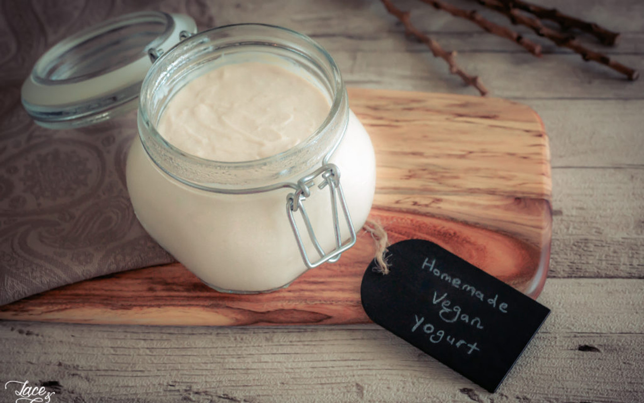
Development of vegan Yoghurt enriched with Dragon Fruit pulp and Peel powder.
Registered numbers :
191FA15052 (CHINMAYA)
191FA15055 ( PRIYADARSHINI)
191FA15057 ( REHANA)
191FA15059 ( LAXMANSAI)
191FA01183 (KEERTHI KIRAN)
PROJECT GUIDE : SUMIT GAWAI

Slide 2
ABSTRACT
Yogurt is a coagulated milk product obtained from the lactic acid fermentation-yogurt made from various milk, whether fresh milk, skim milk, or even full cream milk. The Plant based yogurt is a yogurt made from plant based milk. The additions of red dragon fruit peel may enhance the taste and the therapeutical values. This study was aimed to compare the organoleptic properties, protein, lipid, and flavonoid content of commercial dairy yogurt and Red fruit peel powder vegan yogurt. Red dragon fruit peel yogurt was made with amounts of red dragon fruit peel (15% w/v), plant based milk, starter (Lactobacillus bulgaricus, Lactobacillus acidophilus, Streptococcus thermophilus, Bifidobacterium). Hedonic scale test form was used for measuring organoleptic properties. Various tests like the water content, titrable acidity, pH, ash content and TSS( total soluble solids).Red dragon fruit peel yogurt has a good chance of getting a positive reception from the public and has potential as a functional food.

Slide 3
INTRODUCTION
Dragon fruit comes from tropical climates and is influenced by air humidity, temperature, soil condition, and rainfall. Dragon fruit has good potential in terms of increasing demand with a variety of cultivation techniques that are easy to do. Dragon fruit has high productivity that affects its availability. The high availability of dragon fruit gives a lot of dragon peel waste. Dragon fruit peel has 30-35% of the weight of the fruit and has not been used optimally. Dragon fruit peel has the potential to be developed into functional food.
Dragon fruit peel is a source of natural antioxidants because of the levels of polyphenols (flavonoids,terpenoids,carotene etc). The antioxidants activity in the red dragon fruit peel is higher than the antioxidant activity in the flesh of the fruit. The research showed that in 1 mg/mL, dragon fruit peels could inhibit 83.84% of free radicals. The super red dragon fruit peel has a percentage of DPPH(2,2-diphenyl-1-picryl-hydrazyl-hydrate) free radicals at 79.24%
Plant-based yogurts represent an important segment among the dairy-free alternatives, meeting the needs of many consumers, such as those with dairy allergies and ethical concerns
Among the plant-based sources used for yogurt production, soybean has been especially popular in recent decades because of its protein quantity, quality and functional properties. Furthermore, soymilk has been shown to be a good substrate for the growth of lactic acid bacteria commonly used during yogurt fermentation

Slide 4
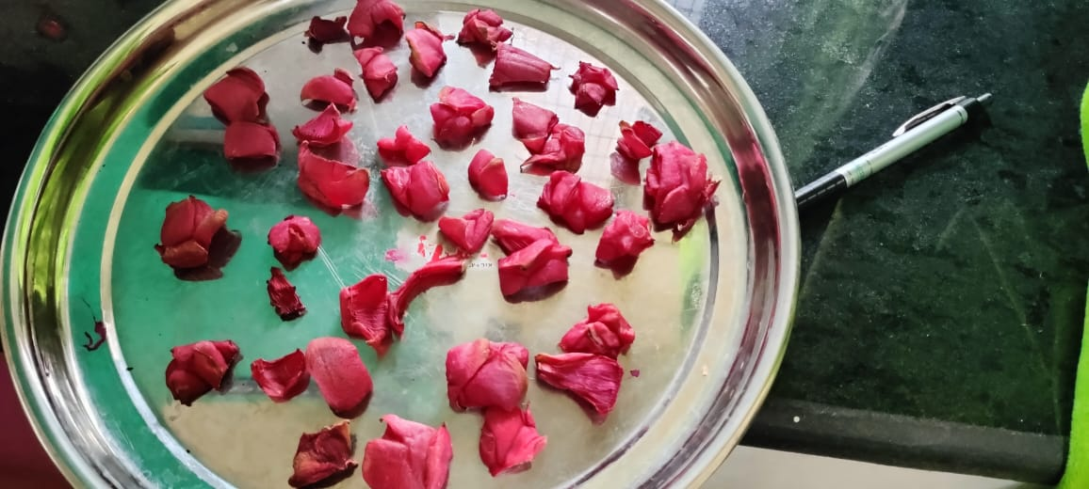
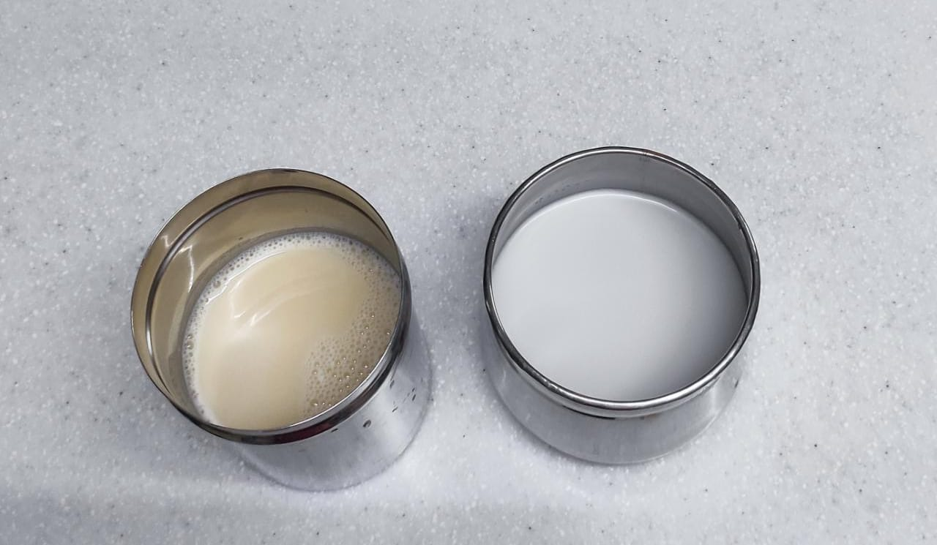
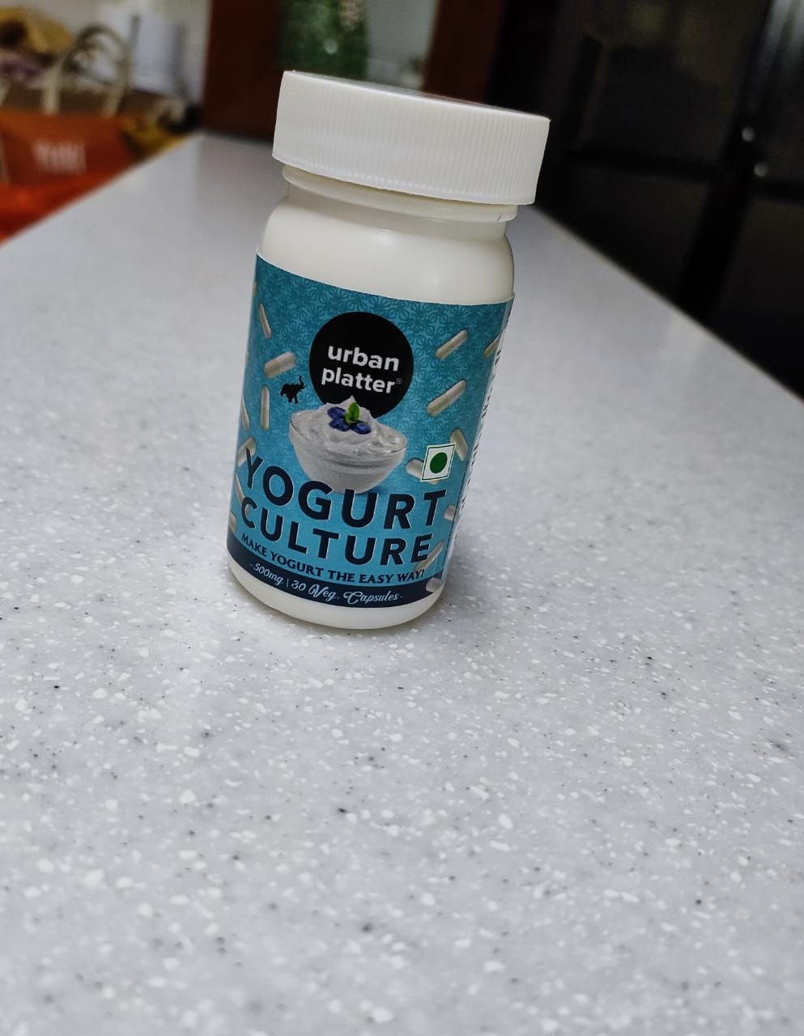
MATERIALS AND METHODS
MATERIALS :
Dragon fruit (H. polyrhizus),was collected from nearby farm.
Coconut milk was bought from the market, Chickpea milk was obtained from Chickpeas, starter culture (lactobacillus acidophilus, lactobacillus rhamnosus, Streptococcus thermophilus), Soy milk was bought from the market.

Slide 5
PREPARATION OF RED DRAGON FRUIT PEEL POWDER:
Red Dragon fruit (H. polyrhizus), cultivated in the nearby farm was collected.
The fruit was washed with tap water and wiped to dry.
The fresh peel was separated from the ripe fruit before cutting into small pieces.
The sample was further dried at 50°C in a hot air oven and ground into powder and filtered using a 100 mesh size filtering.

Slide 6
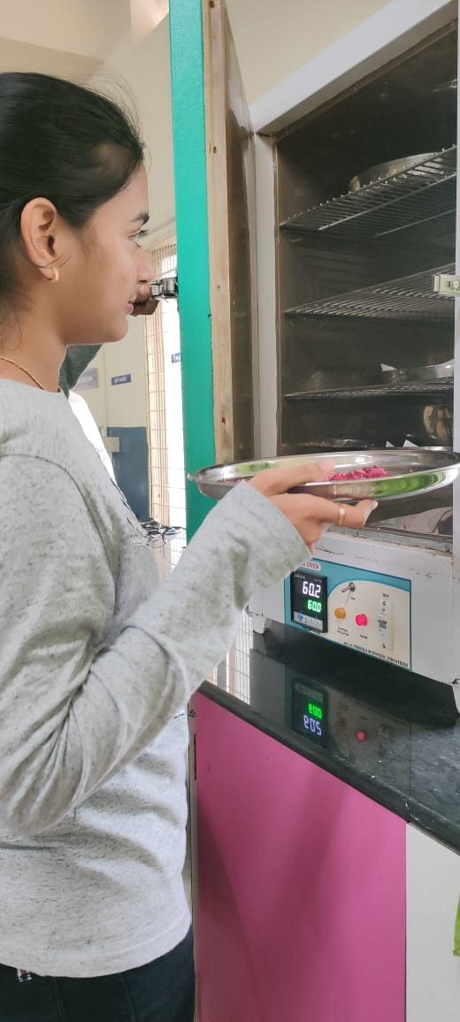
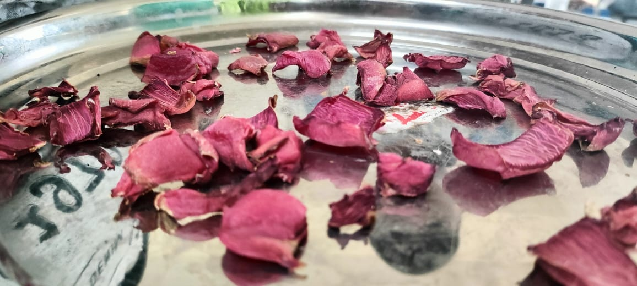
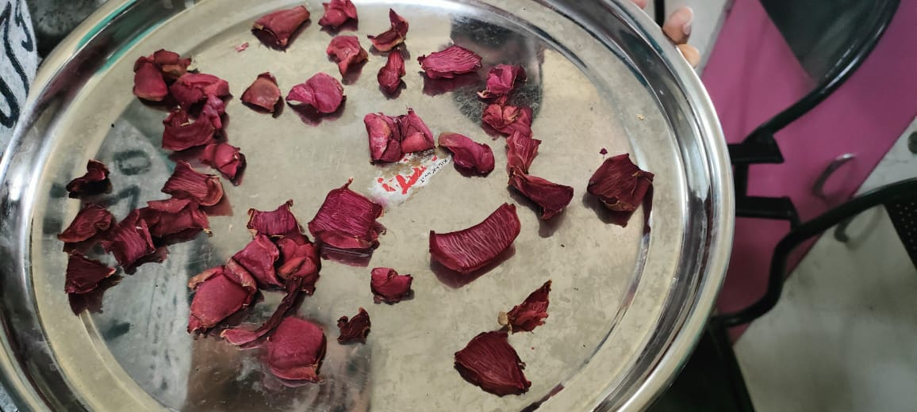
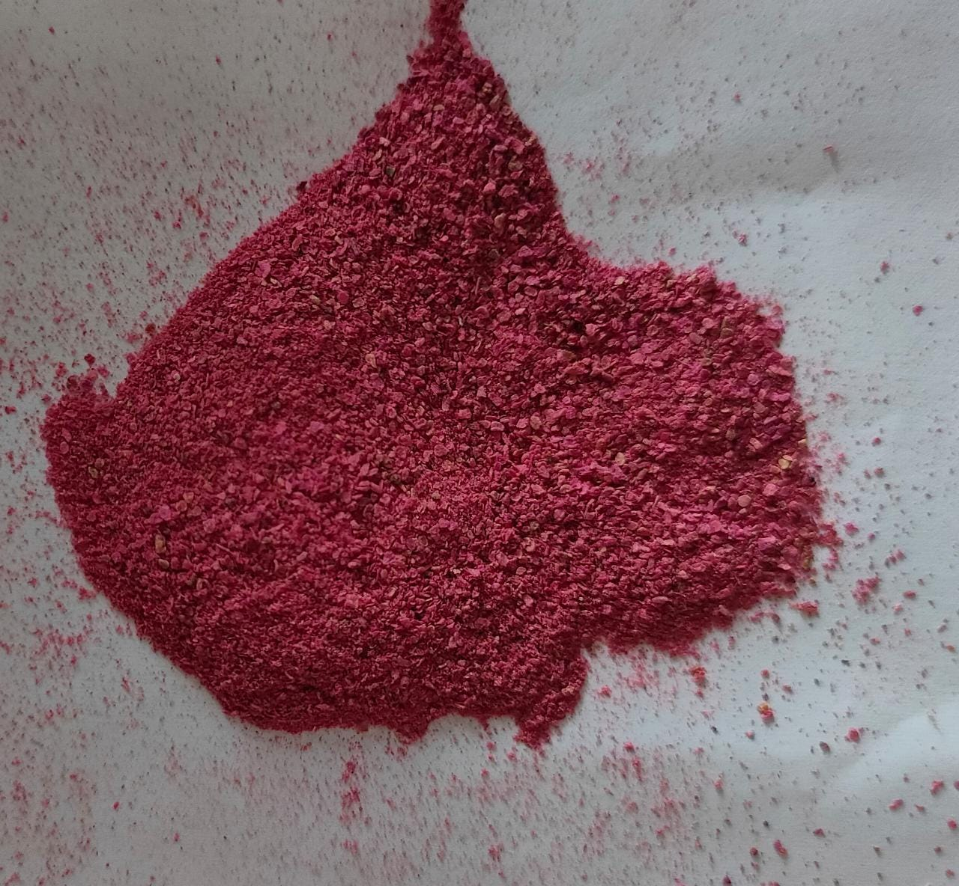
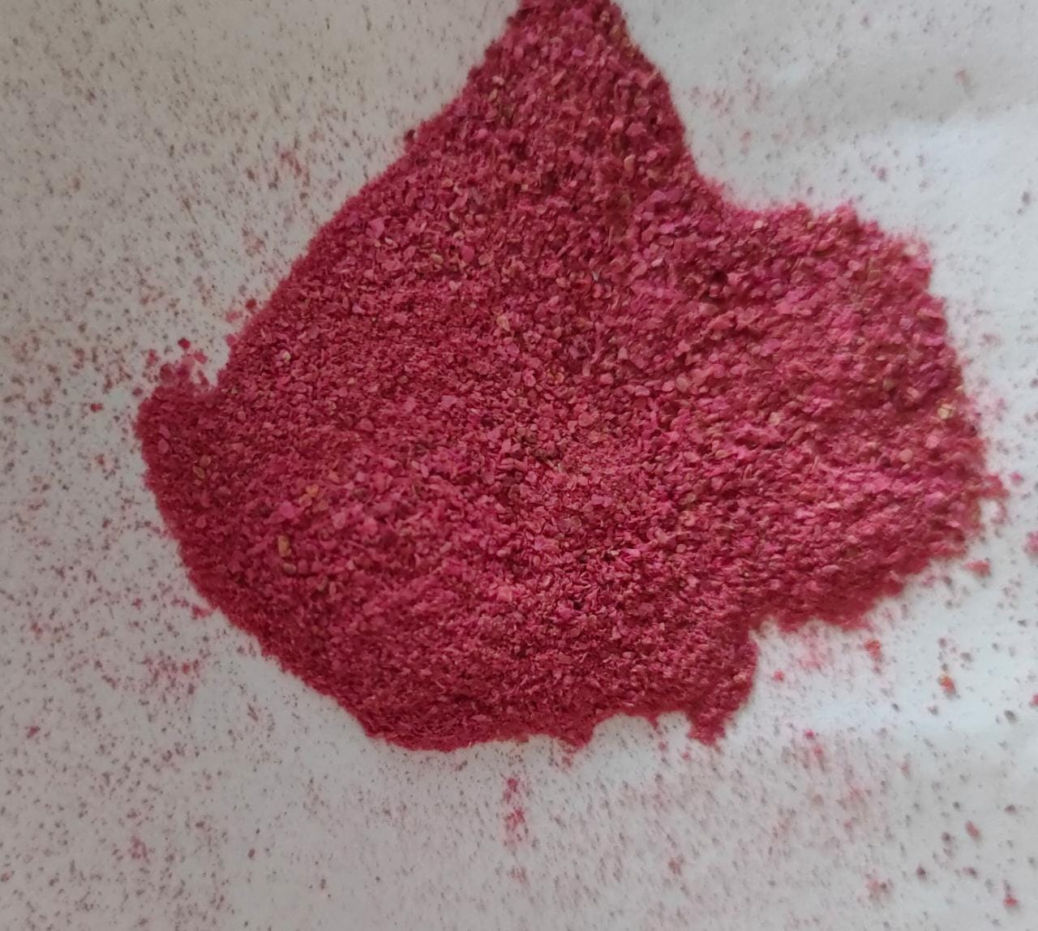
PREPARATION OF DRAGONFRUIT PEEL POWDER
DRYING OF THE PEEL
GRINDING THE PEEL INTO POWDER

Slide 7
PREPARATION OF COCONUT BASED YOGURT
Collection of Coconut milk
Refrigerating the yogurt at 4⁰C
Boiling of the milk at 90⁰C for 5mins
Incubation of the mixture for 24-48 hrs at 40⁰C
Cooling the milk to room temperature.
Inoculating the milk with starter culture
Shake your coconut milk well. Then pour into a clean, sterilized, dry glass jar or bowl. You can easily sterilize clean jars by rinsing throughly with boiling water and letting dry completely.
Empty your probiotic capsules, use a wooden or plastic spoon to stir.
Cover the mixture with lid.
Let the yogurt activate for at least 24 hours and up to 48 hours (sometimes longer – 48 hours is my sweet spot for thickness and tang) in a warm place at 40⁰ C.
Once the yogurt has reached the right amount of tanginess and thickness for your liking (be sure to sample with a wooden spoon), cover securely with a lid and refrigerate until cold.
Store covered in the refrigerator for several days (mine kept for 7 days). You’ll know it’s gone bad when the smell is off or if there is a mold.

Slide 8
PREPARATION OF CHICKPEA YOGURT
Collection of the milk
Inoculation of milk with the starter culture
Incubate the mixture at 40⁰C for 24 hrs and Refrigerate at 4⁰C
Cooling down the milk to normal room temperature
Boiling the milk at 70⁰C for 5 mins
Heat the chickpea milk: Add the milk to a large pot and stir (be sure to stir the starch at the bottom that tends to sink when sitting for a period of time).
Turn the stove on at high heat and once it begins to heat up, reduce to a medium.
Stirring continuously, heat the chickpea milk until it thickens (about 10 minutes). Turn off the heat and continue to stir for another 2 minutes.
Remove the pot from the burner and continue to stir for 2-4 minutes (this will help cool the mixture).
Ferment the chickpea milk: Once the mixture comes to room temperature, transfer it to a clean sterile glass container with a loose lid.
Add the probiotic starter culture to the milk, stir with a wooden spoon. Wrap the lid with a kitchen cloth and then cover.
Let the yogurt incubate at 40⁰C temperature for 12-24 hours. Refrigerate the yogurt at 4⁰C.

Slide 9
PREPARATION OF SOY YOGURT
Collection of the milk
Inoculation of milk with the starter culture
Incubate the mixture at 40⁰C for 24 hrs and Refrigerate at 4⁰C
Cooling down the milk to normal temperature of 42⁰ C
Boiling the milk at 90⁰C for 5 mins
Boil the milk at 90⁰C for 5 mins.
Let it cools completely.
Remove from the heat and let cool to below 42°C.
Starter culture will only thrive in a narrow temperature range, too cool and it will go dormant, too hot and it will die. So be sure to allow the soy milk to cool before adding the starter culture
Add the probiotic powder to the milk.
Incubate the milk for 40⁰C for 24-48hrs.
Refrigerate the yogurt at 4⁰C.

Slide 10
PREPARATION OF RED DRAGON FRUIT PEEL POWDERED YOGURT
Collection of Coconut milk
Incubation of the mixture at 40⁰C for 24-48 hrs
Boiling of the milk at 90⁰C for 5mins
Inoculation of stater culture
Addition of dragon fruit peel powder and honey to milk
Cooling the mixture to a room temperature
Refrigerate the formed yogurt at 4⁰C
Boil the milk at 90⁰C for 5 mins.
Let it cool completely.
Remove from the heat and let cool to below 42°C.
Add 15g of dragon fruit peel powder to the milk.
Add 25g of honey in to the mixture while the mixture is hot.
Starter culture will only thrive in a narrow temperature range, too cool , it will go dormant; too hot , it will die. So be sure to allow the soy milk to cool before adding the starter culture.
Add the probiotic powder to the milk.
Incubate the milk for 40⁰C for 24-48hrs.
Refrigerate the yogurt at 4⁰C.

Slide 11
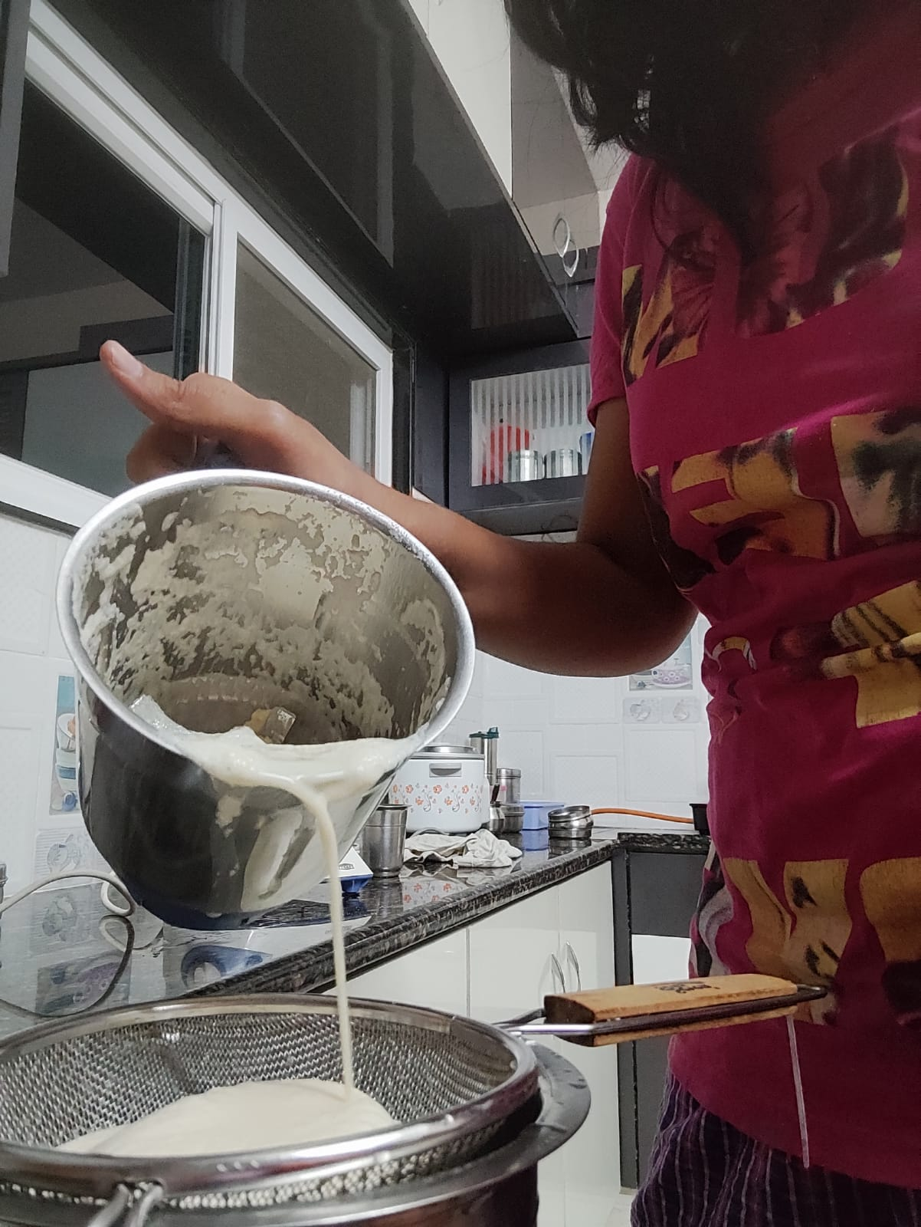
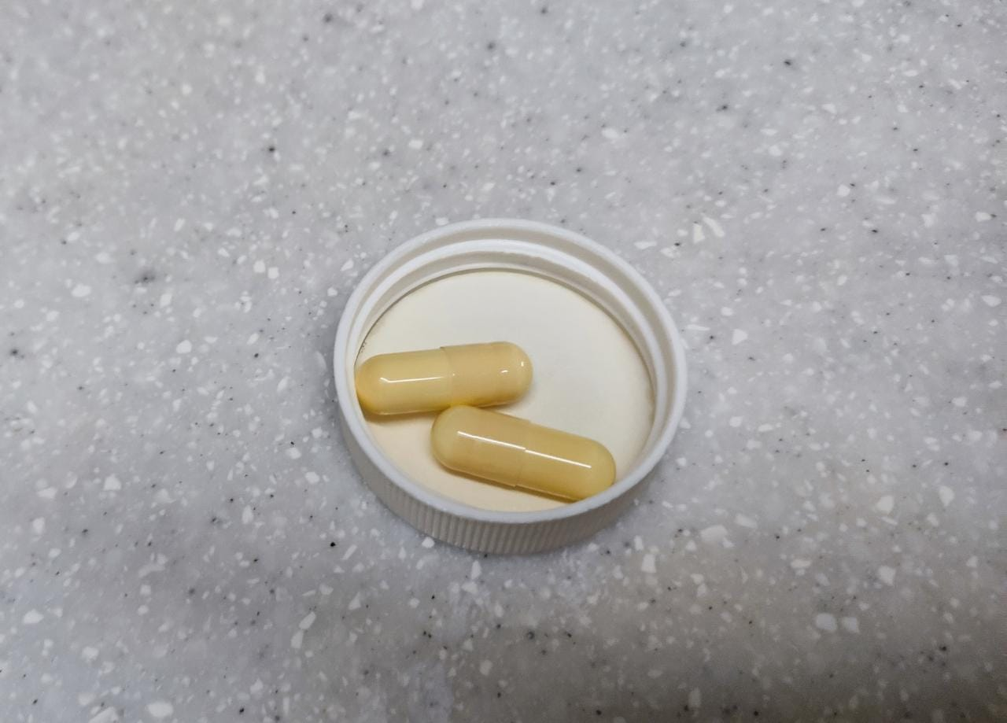
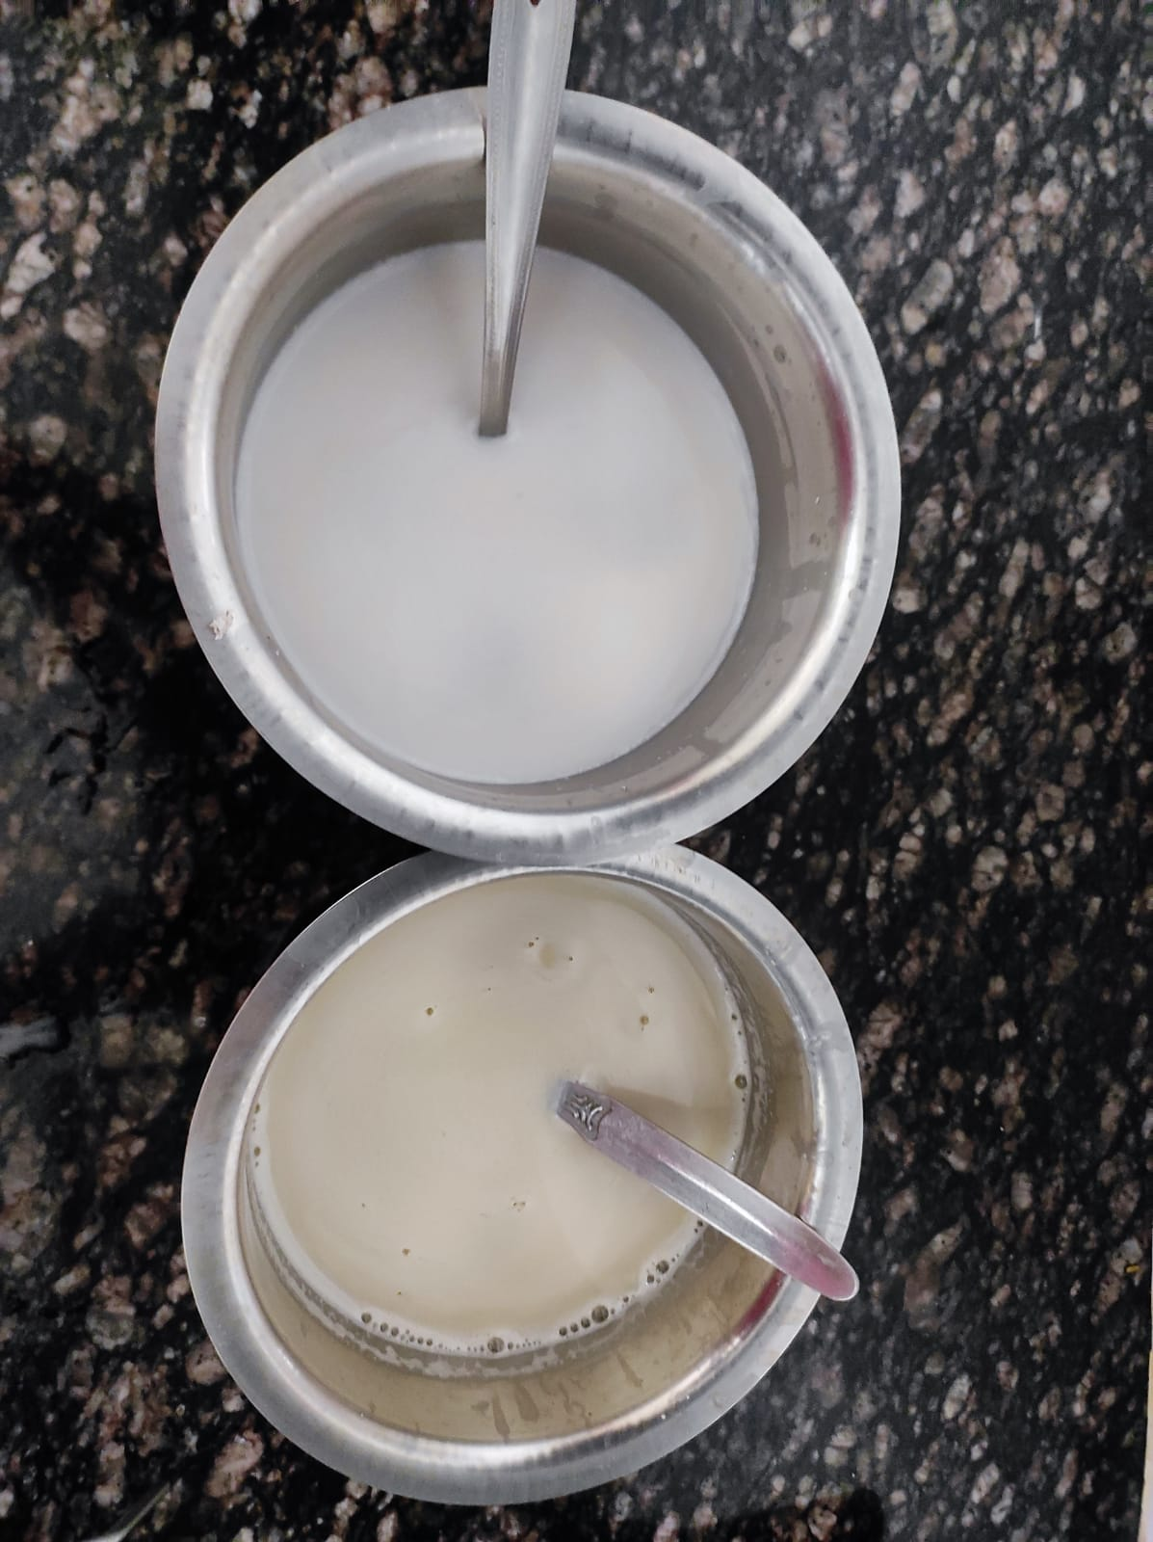
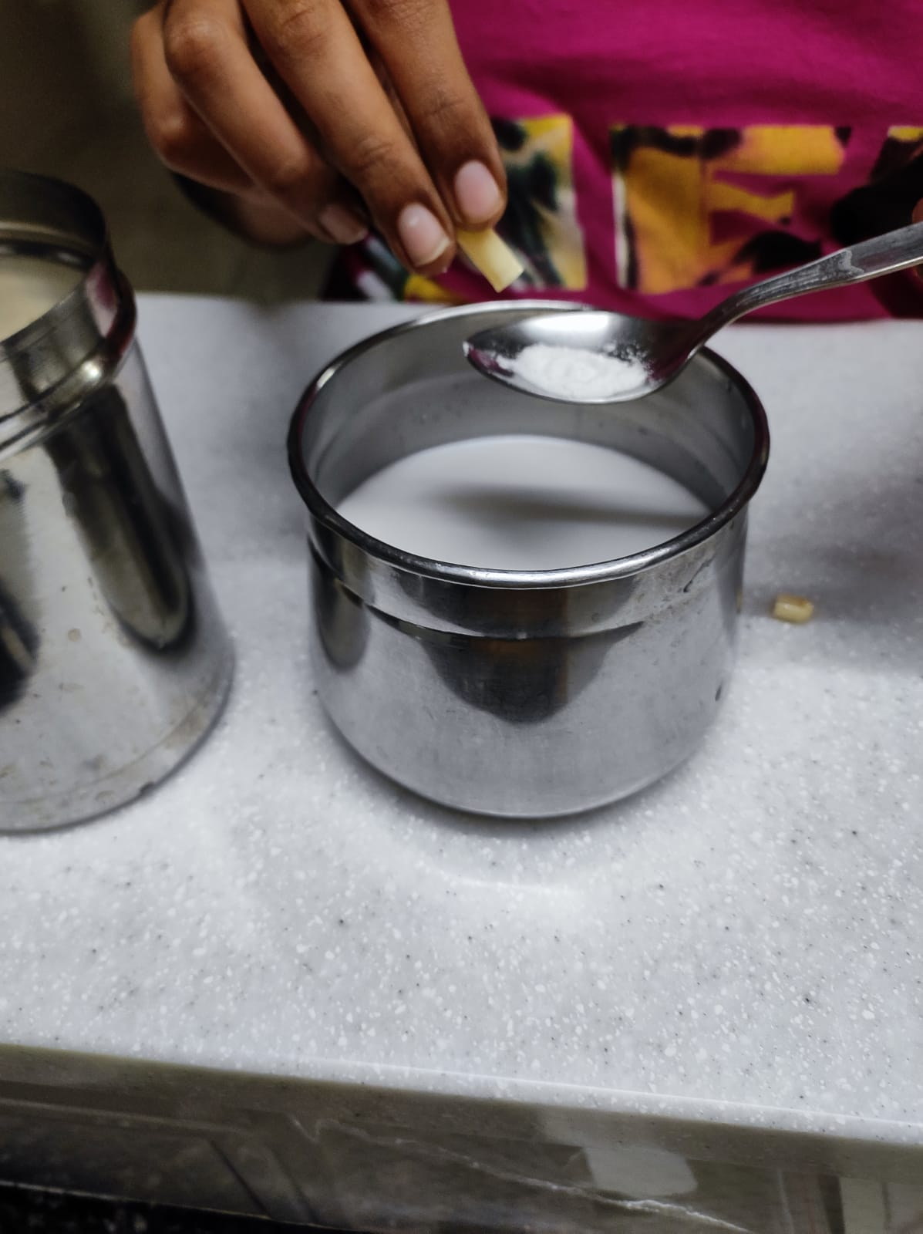
TRIALS OF MAKING OF YOGHURT
PREPARATION OF THE MILK
THE MILK PREPARED
THE STARTER CULTURE
ADDITION OF STARTER CULTURE
INCUBATION FOR 24-48 HRS

Slide 12
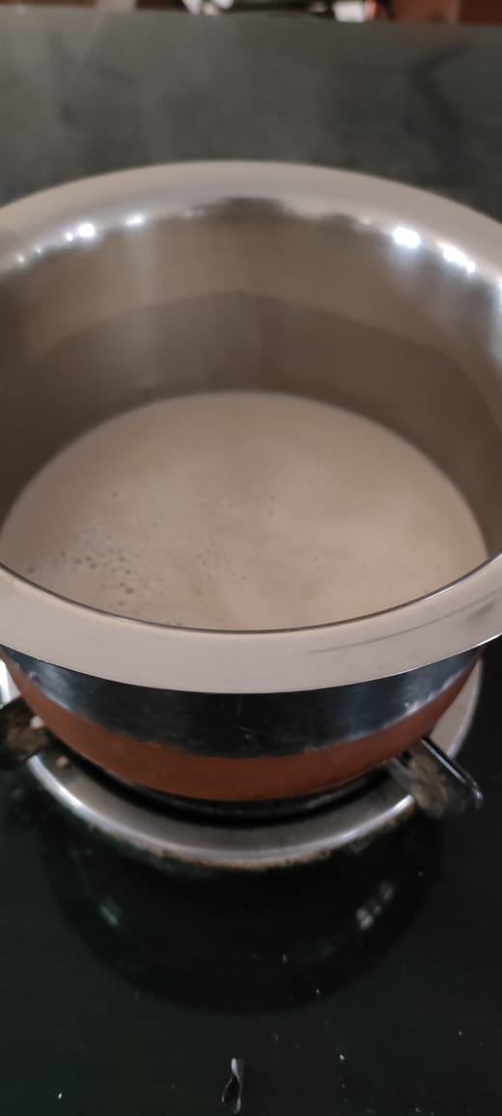
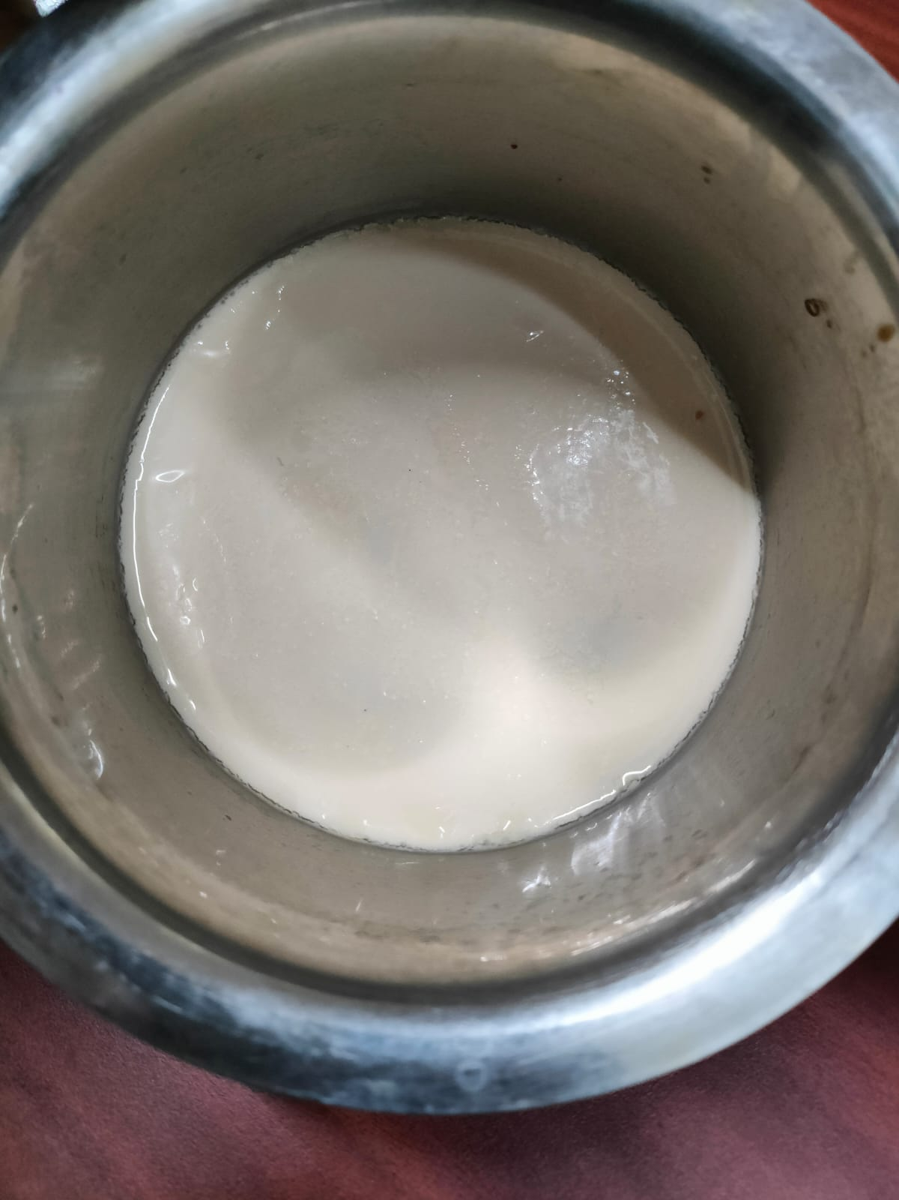
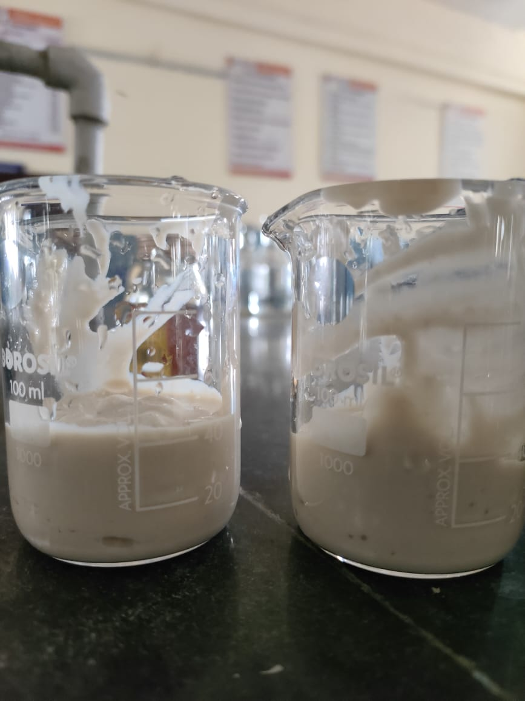
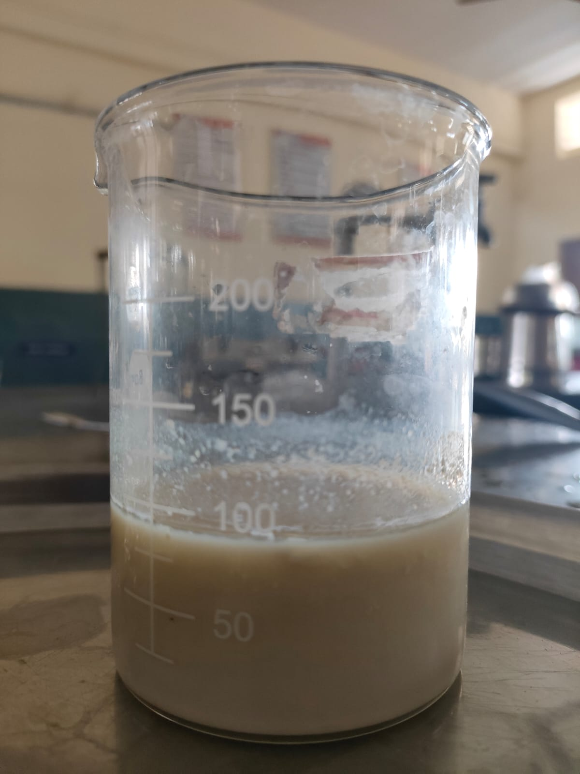
THE TRIALS FOR YOGURT FORMATION
THE MILK BEFORE INCUBATION WITH AL THE CONTENT
THE MILK RIGHT BEFORE INCUBATION
COCONUT AND CHICKPEA YOGURT TRIAL
SOY MILK BASED YOGURT
THE MILK AFTER INCUBATION OF 24 HRS
(the yogurt didn’t set)
THE SOY YOGURT FORMED

Slide 13
PROBLEMS WE FACED WITH THE YOGURT PREPARATION:
Proper conditions were not maintained.
The necessary temperature conditions couldn’t be followed .
The starter culture handling was not done properly.
There were mistakes in incubation for fermentation.
Production of off flavour.
The characteristics of the used milk was looked into for the fermentation to be carried out.
All the parameters were not looked into.
The Formulation for the preparation wasn’t correct.

Slide 14
Sample preparations :
Yogurt sample was mixed with 2.5 mL distilled water then incubated at 45⁰C for 10 mins.
Organoleptic properties :
Organoleptic properties were assessed by a panel of 10 people. They consist of four females and six males. All criteria evaluated were given a score of 1-4 points. Organoleptic tests used a hedonic scale from dislike extremely to like extremely. Criteria included aroma, taste, body texture, color, and visual appearance.
Water content :
Water content determination was the gravimetric method with oven drying. This method involved weighing a homogenized yogurt, oven drying 100-105°C for 3 hrs, reweighing, and calculating the mass of water lost as a percentage of the mass of the dried sample. Results are usually reported as % sample water on a dry mass basis
Ash content :
Ash refers to the inorganic residue remaining after either ignition or complete oxidation of organic matter in the food sample. Determining the ash content of a food is part of proximate analysis for nutritional evaluation, and it is an important quality attribute for some food ingredients. The gravimetric method was made for the determination of ash content on red dragon fruit peel yogurt. The sample is ashed at 600 - 650ºC to constant weight and, the ash is determined by weighing. This method used the dry ashing technique with a muffle furnace to determine the ash content of the sample.
Water content% =
(sample weight – dried sample ) ×100
sample weight
Ash content % =
(weight of the ash collected)×100
Weight of the sample

Slide 15
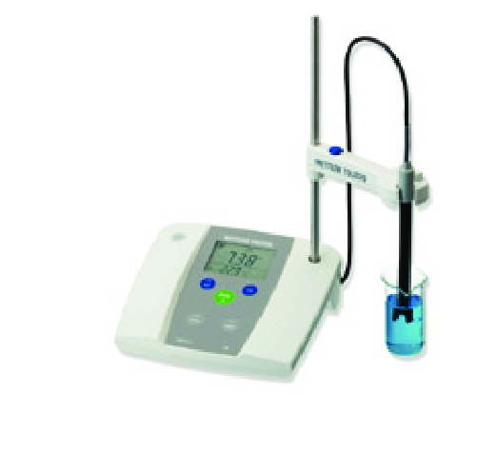
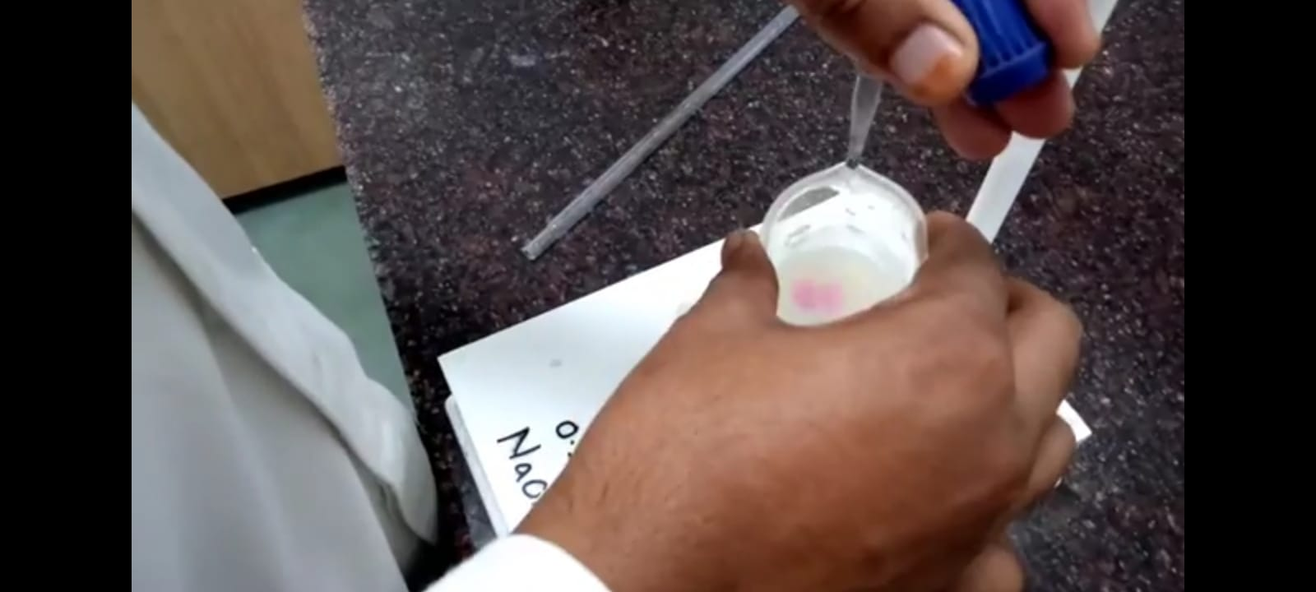
pH of the yogurt:
The pH of the yogurts was measured with a pH meter
Total Titratable Acidity:
Titratable acidity was determined by neutralizing the acid present in 10 g of the commercial yogurt samples using 0.1 N NaOH solution.
The titration was performed using 10 drops of phenolphthalein as indicator until a pale pink endpoint was reached. The quantity of NaOH used to neutralise the solutions was divided by 10 in order to obtain the titratable acidity.
TSS :
Using hand refractometer, the TSS of the sample was recorded.
The hand refractometer is calibrated with the water and then test it for the sample.
TSS is measured in degree brix or percentage
TA% =
(Titre value × Normality of NaOH × 9)
(weight of sample)

Slide 16
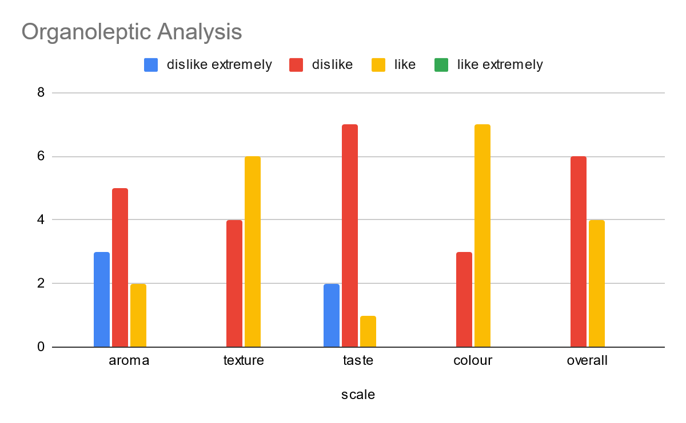
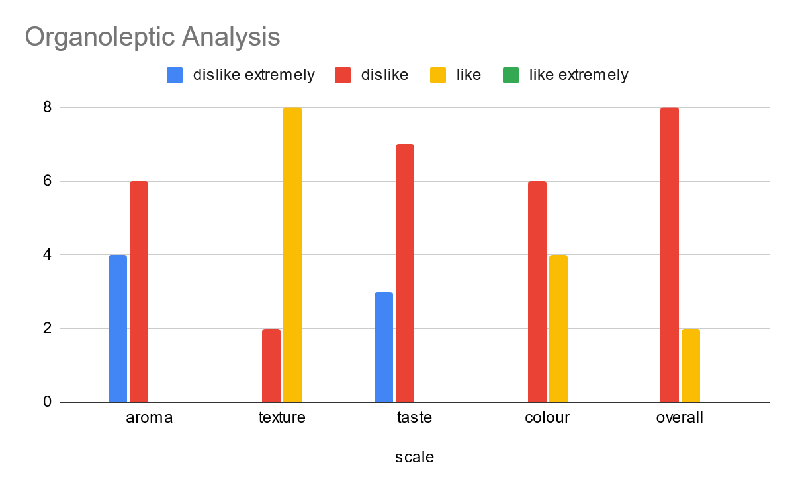
RESULTS AND DISCUSSIONS
THE SCALE (SAMPLE A) | AROMA | TEXTURE | TASTE | COLOUR | OVERALL
1 (Dislike Extremely) | 3 | 0 | 2 | 0 | 0
2 (Dislike) | 5 | 4 | 7 | 3 | 6
3 (Like) | 2 | 6 | 1 | 7 | 4
4(Like Extremely) | 0 | 0 | 0 | 0 | 0
THE SCALE (SAMPLE B) | AROMA | TEXTURE | TASTE | COLOUR | OVERALL
1 (Dislike Extremely) | 4 | 0 | 3 | 0 | 0
2 (Dislike) | 6 | 2 | 7 | 6 | 8
3 (Like) | 0 | 8 | 0 | 4 | 2
4(Like Extremely) | 0 | 0 | 0 | 0 | 0

Slide 17
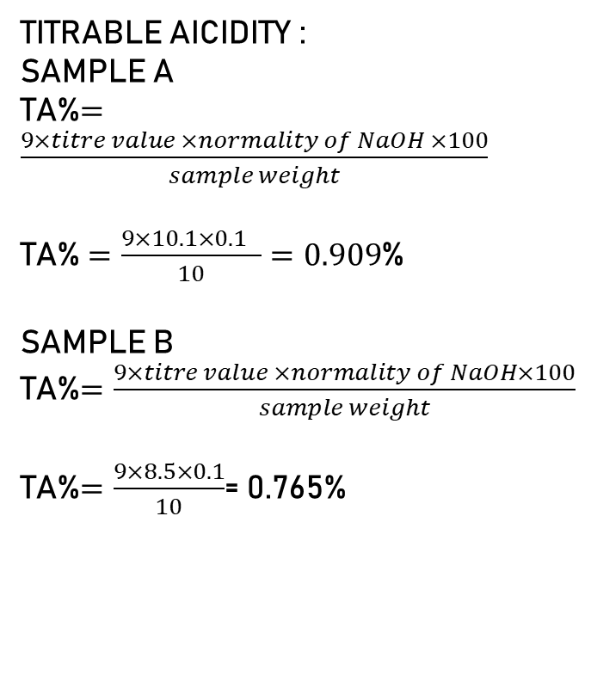
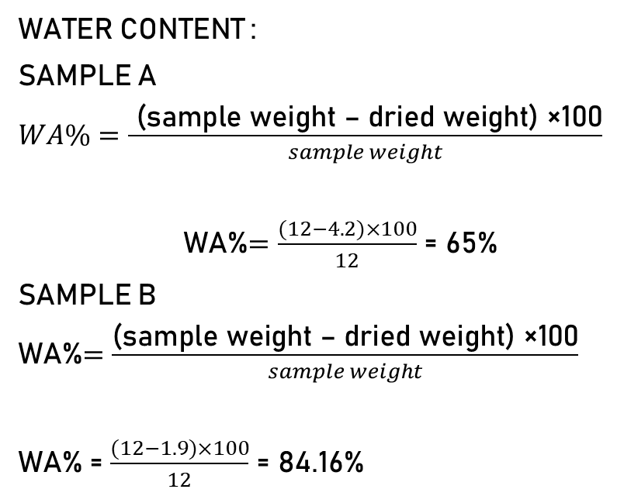
TITRABLE AICIDITY :
SAMPLE A
TA%$=\frac{9×titre value ×normality of NaOH ×100}{sample weight}$
TA% $=\frac{9×10.1×0.1 }{10}=0.909$%
SAMPLE B
TA%$=\frac{9×titre value ×normality of NaOH×100}{sample weight}$
TA%$=\frac{9×8.5×0.1}{10}$= 0.765%
WATER CONTENT :
SAMPLE A
$WA\%=\frac{\text{ (}\text{sample} \text{weight}\text{ – }\text{dried} \text{weight}\text{) }\text{×}\text{100}}{sample weight}$
WA%$=\frac{(12−4.2)×100}{12}$ = 65%
SAMPLE B
WA%$=\frac{\text{(}\text{sample} \text{weight}\text{ – }\text{dried} \text{weight}\text{) }\text{×}\text{100}}{sample weight}$
WA% = $\frac{(12−1.9)×100}{12}$ = 84.16%

Slide 18
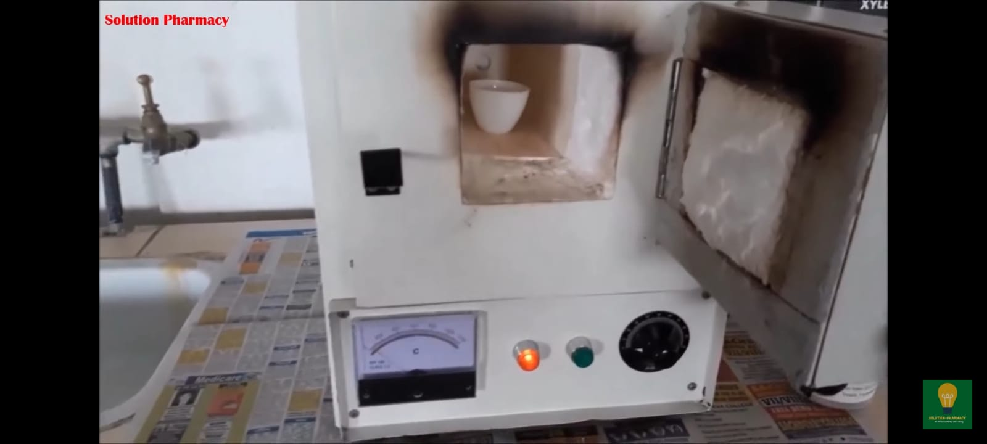
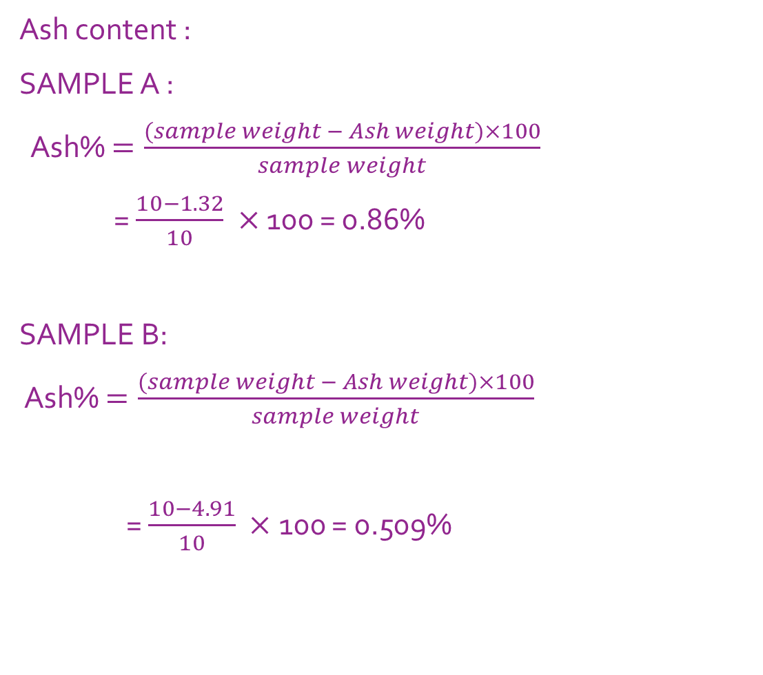
Ash content :
SAMPLE A :
Ash% $=\frac{(sample weight − Ash weight)×100}{sample weight}$
= $\frac{10−1.32}{10} ×$ 100 = 0.86%
SAMPLE B:
Ash% $=\frac{(sample weight − Ash weight)×100}{sample weight}$
= $\frac{10−4.91}{10} ×$ 100 = 0.509%

Slide 19
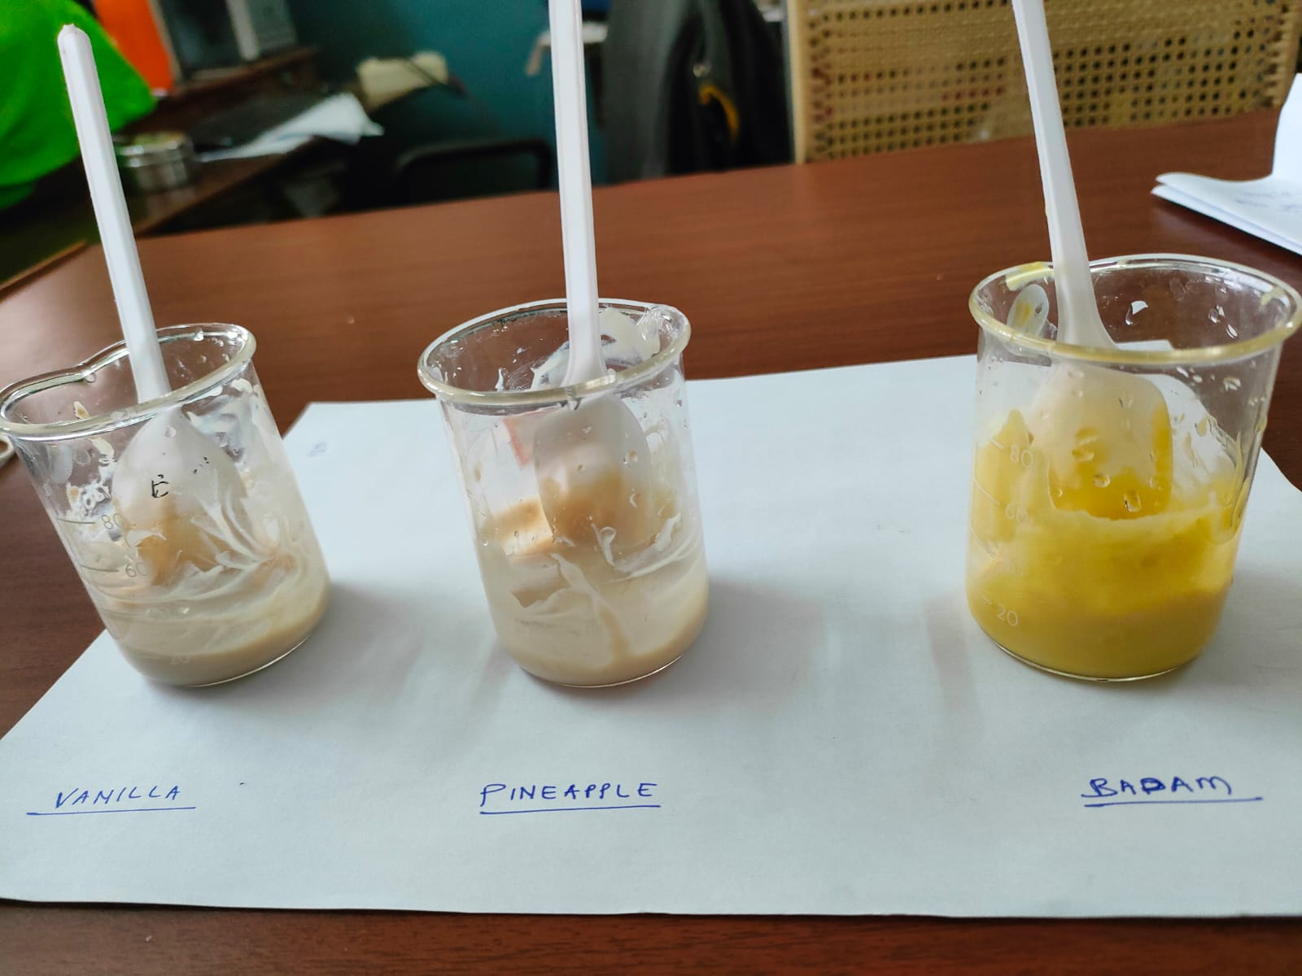
RESULTS AND DISCUSSIONS :
SAMPLES | WA% | TA% | pH | TSS | ASH%
A | 65 | 0.909 | 4.51 | 8.9 | 0.86
B | 84.16 | 0.765 | 4.89 | 11.4 | 0.509
SAMPLE A :
Red dragon fruit peel soy based yogurt.
We tried adding the flavours for the enhancement of the flavour the prepared by adding the flavours (a) vanilla (b) pineapple (c) Badam.
Due to time limitations we couldn’t do the sensory analysis for the prepared flavours of red dragon peel powder yogurt.
SAMPLE B :
Soy based yogurt

Slide 20
CONCLUSIONS:
Red dragon fruit peel yogurt has a good chance of getting a positive reception from the public. Red dragon fruit peel yogurt has potential as a functional food because of its high flavonoid content and low lipid content. The red dragon fruit peel yogurt is suitable for consumption not only by healthy people but also by those who have metabolic diseases, such as dyslipidemia and diabetes as it contains flavonoid, fiber, and lactic acid bacteria that could help decrease blood sugar, cholesterol and triglyceride levels.
The study depicted that the acidity of the red dragon peel powdered yogurt is higher than the acidity of the soy based yogurt. The sensory analysis showed that the red dragon fruit peel yogurt has higher acceptability than the normal soy yogurt.
The red dragon fruit peel yogurt had a problem of taste for acceptability which can be improved by further research and formulations, hence red dragon fruit peel yogurt can be a good functional food which can be a good alternative for the usual dairy based yogurt.

Slide 21
THANK YOU

